Slide 1
PROJECT PROPOSAL DOCUMENT
PROJECT PROPOSAL FOR PESA MASHINANI

Slide 2
STUDENT DETAILS
REG. NO. COM/B/01-00106/2018
NAME. BORNFACE SONYE
PHONE NUMBER. 0798073204
EMAIL. Comb01-001062018@student.mmust.ac.ke
COURSE CODE. BCS 417
COURSE NAME. COMPUTER SCIENCE PROJECT 2
SUPERVISOR: MADAM RAMBIM

Slide 3
THE PROJECT TITLE
Pesa Mashinani
Pesa Mashinani is a web-based application aimed at connecting money lenders and borrowers, improving financial security, and minimizing loan defaults. The system, developed using the Django framework, will streamline the process of loan applications, disbursements, and repayments. By incorporating machine learning algorithms and integrating external data from banks, the application will provide a more efficient and secure lending platform.

Slide 4
ABSTRACT
Pesa Mashinani is a web-based application aimed at connecting money lenders and borrowers, improving financial security, and minimizing loan defaults. The system, developed using the Django framework, will streamline the process of loan applications, disbursements, and repayments. By incorporating machine learning algorithms and integrating external data from banks, the application will provide a more efficient and secure lending platform.

Slide 5
1. INTRODUCTION
1.1 Background of the Study
Loan defaulters present a significant risk to lenders, causing financial losses and operational challenges. Current systems lack robust mechanisms to assess the financial traits of borrowers accurately.
Pesa Mashinani aims to revolutionize the financial lending landscape by creating a secure and efficient platform for money lenders and borrowers. The application will facilitate seamless interactions between banks, youth and women groups, and individual borrowers while ensuring robust loan security measures.

Slide 6
2. PROBLEM DEFINATION
2.1 Current System workflow
Registration and Verification: Users register and verify their accounts.
Loan Application: Borrowers fill out and submit loan applications.
Loan Approval and Disbursement: A panel manually reviews, approves, and disburses loans.
Repayment: Borrowers repay loans according to the agreed schedule.
Revenue Model: Revenue is generated through interest and fees collected.

Slide 7
2. PROBLEM DEFINATION
2.2 Weaknesses of the current system
Time-consuming during manual approval
Prone to errors and potential corruption
Increased risk of default
Inadequate creditworthiness assessments
Lack of security measures for lenders
Limited integration of external financial data for comprehensive credit checks

Slide 8
2. PROBLEM DEFINATION
2.3 The Proposed Idea
Pesa Mashinani will address these weaknesses by:
Automating loan application, allocation, approval, disbursement and repayment processes.
Creditworthiness Evaluation: Integration with external data sources (e.g., defaulters lists) and machine learning algorithms for accurate assessment.
Group Accountability: Borrowers tied to groups with guarantors, increasing accountability and reducing defaults.

Slide 9
3. OBJECTIVES
3.1 General objective
To develop a secure and efficient web-based platform that links money lenders with loan borrowers, automating loan processes and ensuring financial trustworthiness through advanced credit checks.

Slide 10
3. OBJECTIVES
3.2 Specific Objectives
Develop a user-friendly interface for borrowers to apply for loans and manage their accounts.
To integrate external data sources for enhanced borrower assessment.
Implement an admin interface for system management and oversight.
To utilize machine learning algorithms to propose loans based on financial performance.

Slide 11
4. PROBLEM JUSTIFICATION
Automating the loan process reduces human error, increases efficiency, and enhances financial security. By using machine learning for credit assessments, the system provides more accurate and reliable evaluations, reducing the risk of loan defaults.
Automating the current system will eliminate manual errors, and speed up loan processing times. By incorporating machine learning and external data integration, Pesa Mashinani will provide a more accurate and secure lending environment.

Slide 12
5. LITERATURE
5.1 The Current System
Current money lending platforms involve manual processes, lack integration with external data, and do not leverage modern technologies like machine learning. These limitations lead to inefficiencies and increased loan default rates.

Slide 13
5. LITERATURE
5.2 Challenges and Limitations of the Current System
Manual loan approval processes prone to errors and corruption.
Lack of integration with defaulters' lists and other external data.
Inability to assess borrowers' financial traits using modern technologies.
No system to tie borrowers to groups, reducing accountability and increasing default rates.

Slide 14
5. LITERATURE
5.3 Conceptual Design
5.3.1 User Interface
5.3.1 .1 Borrower Interface:
Registration
Login
Loan application form
Loan details
Loan Repayment form
Transaction history.

Slide 15
5. LITERATURE
5.3 Conceptual Design
5.3.1 User Interface
5.3.1 .2 Lender Interface:
Registration
Login
Loan allocation form
Loan Disbursement form
Defaulter listing form
Transaction history.

Slide 16
5. LITERATURE
5.3.1 .3 Group Administrator Interface:
Members Management(add members, update members details, approve members for loans)
Registration.
Login .
Loan allocation form.
Loan Disbursement form.
Defaulter listing form.
Loan application form.
Loan details.
Loan Repayment form.
Transaction history.

Slide 17
5. LITERATURE
5.3 Conceptual Design
5.3.1 User Interface
5.3.1 .4 Admin Interface:
User registration(lender, group and borrower)
User Management
System monitoring
Reporting.

Slide 18
5. LITERATURE
5.3.1 .4 Help Interface:
User guides
System rules and Roles
Interface for downloading guarantor form

Slide 19
5. LITERATURE
5.3 Conceptual Design
5.3.2 Report Generation
The system will generate detailed reports on loan applications, approvals, disbursements, repayments, and defaulters, providing valuable insights to lenders and administrators.
Automated reports generation and download on:
Transaction history for all users.

Slide 20
5. LITERATURE
5.3 Conceptual Design
5.3.3 Data Management
Efficient data management will ensure secure storage, retrieval, and processing of user information, loan details, and financial transactions.

Slide 21
6. METHODOLODY
6.1 Model
An iterative and incremental development approach will be followed to ensure continuous improvement and integration of user feedback.
Consisting of the following stages:
Requirements Analysis: Conduct a thorough analysis of requirements gathered from stakeholders and the conceptual design phase. Define the scope, objectives, and functional requirements of Pesa Mashinani application.
System Design: Develop a detailed system design based on the conceptual design, outlining the architecture, components, and data structures. Identify the necessary technologies and tools for the implementation phase.
Implementation (Coding): Begin the coding phase, implementing the functionalities and features outlined in the system design. Utilize the chosen technology stack, including HTML, CSS, JavaScript, Python, and the Django Web Framework, to build Pesa Mashinani web application.

Slide 22
6. METHODOLODY
6.1 Model
Testing: Conduct rigorous testing at each iteration to ensure that individual components and features meet specified requirements. Address any issues or bugs identified during testing promptly to maintain the quality of Pesa Mashinani.
Incremental Enhancements: Implement additional features and functionalities in incremental stages based on feedback, emerging requirements, and evolving needs. Continuously refine Pesa Mashinani to improve performance, security, and user experience.
User Training and Documentation: Develop comprehensive user documentation and conduct training sessions for end-users, including lenders, groups, and borrowers. Ensure that users are proficient in utilizing the functionalities of Pesa Mashinani.

Slide 23
6. METHODOLODY
6.1 Model
Deployment: Deploy the system to a live environment, making it accessible to users for real-world application and testing. Monitor deployment processes to ensure smooth transition and minimal disruption to operations.
Monitoring and Maintenance: Implement a monitoring system to track the usage, performance, and security of Pesa Mashinani. Provide ongoing maintenance and support to address any issues, updates, or enhancements needed post-deployment, ensuring the continued functionality and effectiveness of Pesa Mashinani.

Slide 24
6. METHODOLOGY
6.2 System Requirements
6.2.1 Functional Requirements
User registration and authentication
Loan allocation, application, disbursement and repayment
Group members management
Add group member
Update group member details
Delete group member
Approve member for loan
System Users Management
Machine learning algorithms for loan assessment.
Transactions listing
Reporting and analytics

Slide 25
6. METHODOLOGY
6.2 System Requirements
6.2.2 Non-Functional Requirements
Security:
Implement stringent security measures to safeguard user data, prevent unauthorized access, and ensure compliance with data protection laws and regulations.
Scalability:
Design the system to be scalable, capable of handling a growing user base and increasing data volumes without compromising performance or user experience.
Performance:
Optimize system performance to deliver fast response times, minimal loading delays, and efficient data processing, enhancing user satisfaction and productivity.
Reliability:
Ensure high system reliability and availability, minimizing downtime and service interruptions to maintain continuous access for users.

Slide 26
7. SYSTEM DESIGN: The Component Diagram;

Slide 27
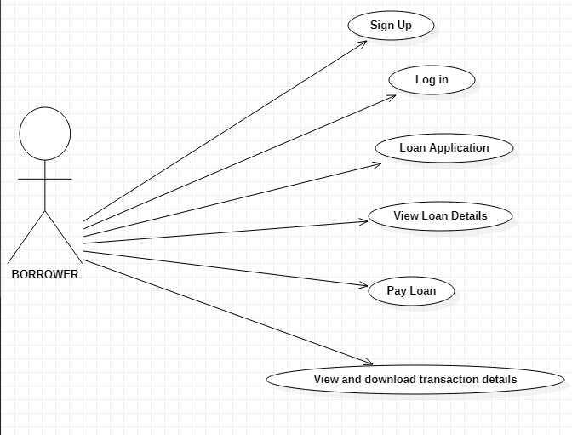
7. SYSTEM DESIGN: Use Case Diagram (Borrower );

Slide 28
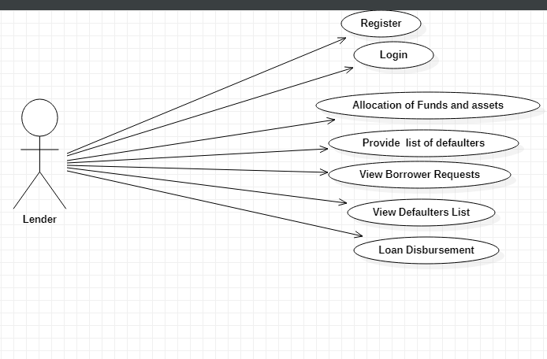
7. SYSTEM DESIGN: Use Case Diagram (Lender);

Slide 29
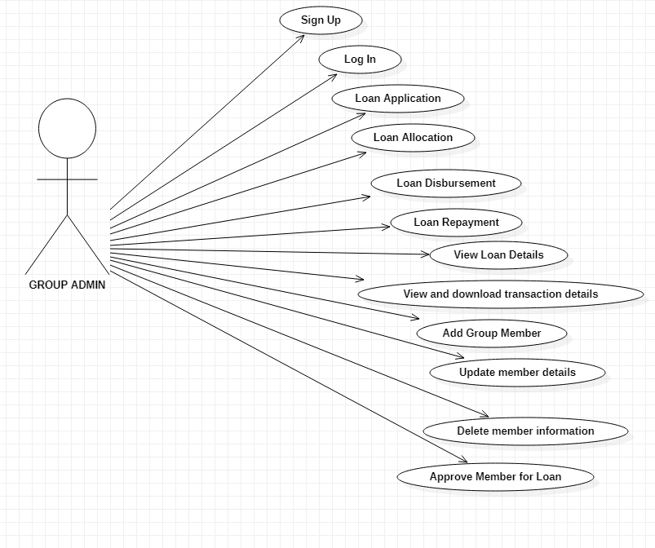
7. SYSTEM DESIGN: Use Case Diagram (Group Admin);

Slide 30
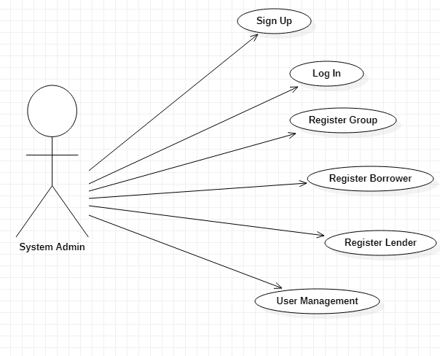
7. SYSTEM DESIGN: Use Case Diagram (Admin);

Slide 31
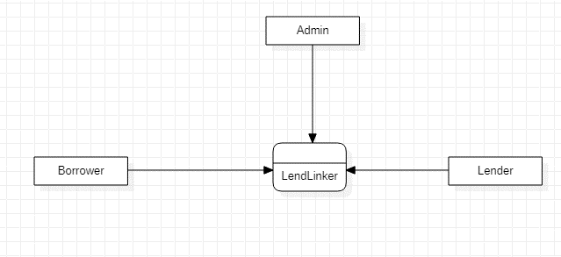
7. SYSTEM DESIGN: Context Diagram;

Slide 32
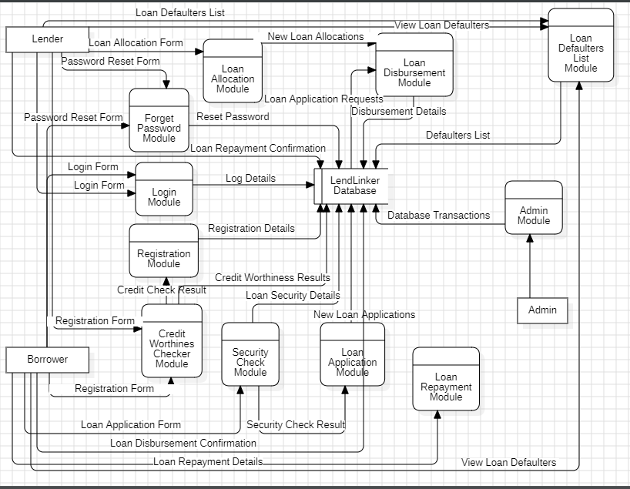
7. SYSTEM DESIGN: Level 1 DFD;

Slide 33
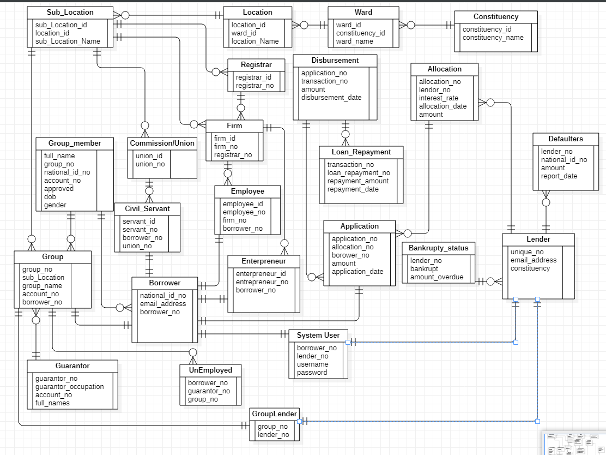
7. SYSTEM DESIGN: Database Design;

Slide 34
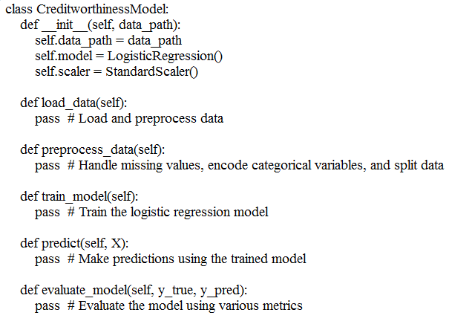
7. SYSTEM DESIGN: ML Algorithm;

Slide 35
7. SCHEDULE
Initiation Phase:
May 27th - June 10th: Requirements gathering and initial design
Planning Phase:
June 11th - July 1st: UI/UX design and database setup
Implementation Phase:
July 2nd - July 25th: Core functionality development (user registration, loan application)
July 26th - August 10th: Integration of machine learning algorithms and external data sources
Testing Phase:
August 11th - August 13th: Testing and bug fixing
Deployment Phase:
August 14th - August 15th: Deployment and final documentation

Slide 36
8. BUDGET
Total budget of 750,000 Kshs allocated as follows:
Development Tools and Licenses: 150,000 Kshs
Server and Hosting Costs: 200,000 Kshs
Machine Learning Integration: 100,000 Kshs
Testing and Quality Assurance: 100,000 Kshs
Miscellaneous Expenses: 200,000 Kshs

